Slide 1

Sinhala Book Recommendation System
Chinthaka Perera
19440677 / 2019/MCS/067
Supervised by:
Prof. M.G.N.A.S. Fernando

Slide 2
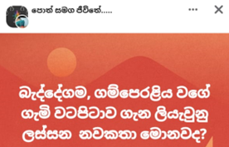
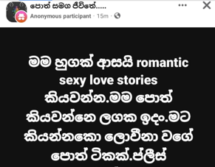

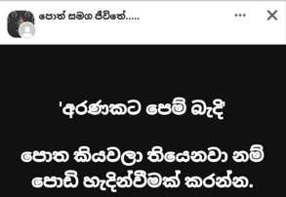
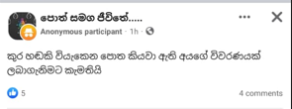
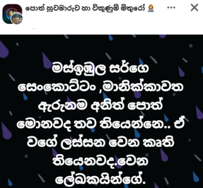
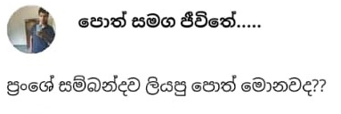



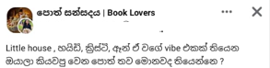
Problem statement

Slide 3
Recommendation systems

Slide 4
Research gap

Slide 5
Scope of the study

Slide 6
Literature works

Slide 7
architecture

Slide 8
challenges
To collect a data set

Slide 9
demo

Slide 10
limitations
The books published after 2022 were considered.
Age range has not been considered for recommendation.

Slide 11
Evaluation

Slide 12
Future enhancement
Collect more data to enhance the accuracy.
Display the dropdown book list in Sinhala fonts in data collection form.
Consider latest books.
Include a book purchase facility by routing to an online book store.
Include more filters like genre
Include more details of a book like number of pages, published year, ISBM number

Slide 13

Thank you

